Slide 1
Continuous Integration & Continuous Delivery using AWS CloudFormation

Slide 2
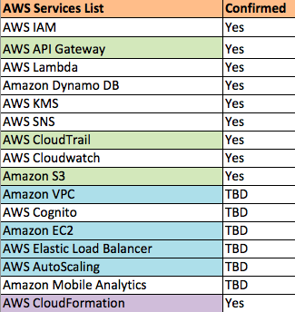
List of AWS Services NAPI Utilizes

Slide 3
Why do we need continuous Integration and delivery?
To manage the workflow that creates and updates infrastructure resources
To properly test and inspect the changes for defects and potential issues
To maintain traceability of the changes made.

Slide 4
Methods Amazon offers for CD
AWS CloudFormation
Offers Reusability
Ease of Maintenance and Configuration
Allows preview of the changes
Stable Tool
AWS CloudFormer
Beta Version tool
Auto generated code
Difficult to track changes

Slide 5
Design Objectives
Reusability
Modularity
Abstraction

Slide 6
Design

Slide 7
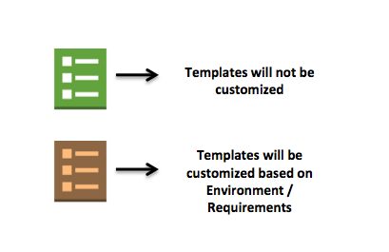
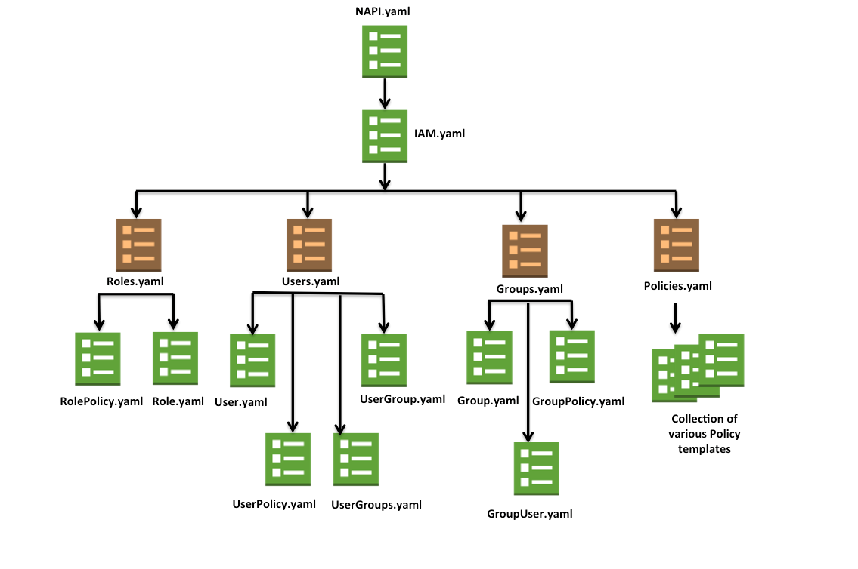
CI/CD AWS IAM

